Slide 1
Linux for Network Storage
By:
Tarun Tanmay N049 Jai Verma N060
Suyog Shanker N065 Parth Saraf N066

Slide 2
What is network storage
A network is a collection of computers, servers, mainframes, network devices, peripherals, or other devices connected to one another to allow the sharing of data.
Storage is archiving data in electromagnetic or other forms for use by a computer or device.
Network Storage is the collective processes of interconnecting external storage resources and devices over a network to all connected computers or devices.
Network storage makes it possible to share one or more storage resources on a network in an IT environment, where a single storage server can be used to provide storage capacity to multiple users simultaneously.

Slide 3
Need of network storage
Over the years, the storage of data has evolved through various phases. This evolution has been driven partly by the changing ways in which we use technology, and in part by the exponential increase in the volume of data we need to store. It has also been driven by new technologies, which allow us to store and manage data in a more effective manner.
In the days of mainframes, data was stored physically separate from the actual processing unit, but was still only accessible through the processing units. As PC based servers became more commonplace, storage devices went ‘inside the box’ or in external boxes that were connected directly to the system. Each of these approaches was valid in its time, but as our need to store increasing volumes of data and our need to make it more accessible grew, other alternatives were needed.
Cloud services and other new forms of remote storage also add to the capacity of devices and their ability to access more data without building additional data storage into a device. Enter network storage.

Slide 4
Types of Network Storage Solutions
Storage Area Networks (SAN)
A SAN is a high-performance, dedicated storage network. It transfers data between storage devices and servers. In the SAN infrastructure, fibre channel is used to connect devices such as RAID arrays, DAS or tape libraries to servers
Network Attached Storage (NAS)
It is a special purpose device. It comprises hard disks, as well as management software. NAS is dedicated 100% to serve files over a network. In simple terms, NAS shares storage over a network.
Direct Attached Storage (DAS)
Direct attached storage is the term used to describe a storage device that is directly attached to a host system. The simplest example of DAS is the internal hard drive of a server computer

Slide 5
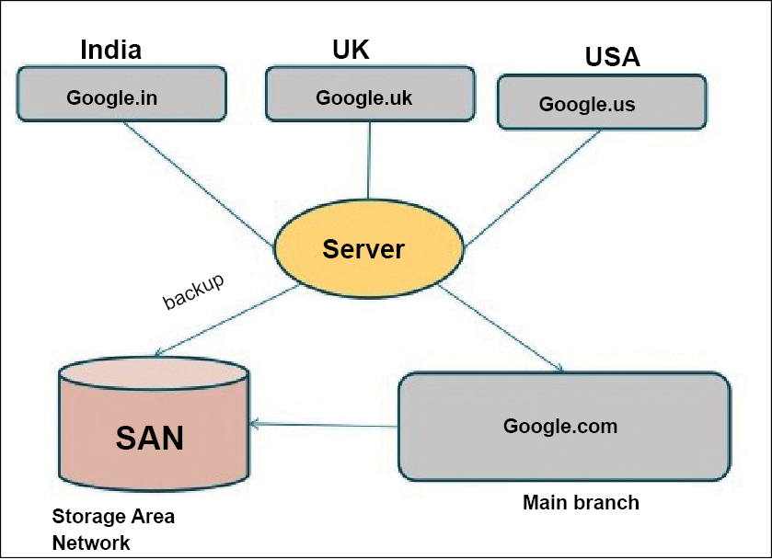
SAN (Storage Area Network)
SAN stands for Storage Area Network. It is commonly defined as an architecture which attaches remote computer storage devices to servers in a way that makes the devices appear as if they are locally attached to the OS.
It has Block-Level Operations and uses the Fiber Channel, iSCSI, and ATA over Ethernet protocols.

Slide 6
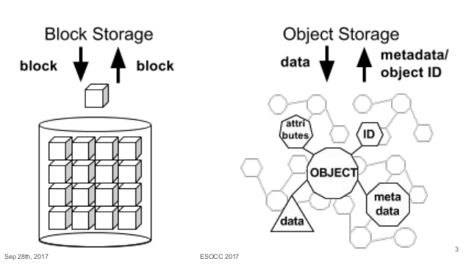
SAN is Block Level Storage
A block level is simply the sequence of bytes or bits that have a nominal length.
It is used to facilitate the handling of the data-stream by the computer which is receiving the data.
Block level data is read one block at a time.

Slide 7
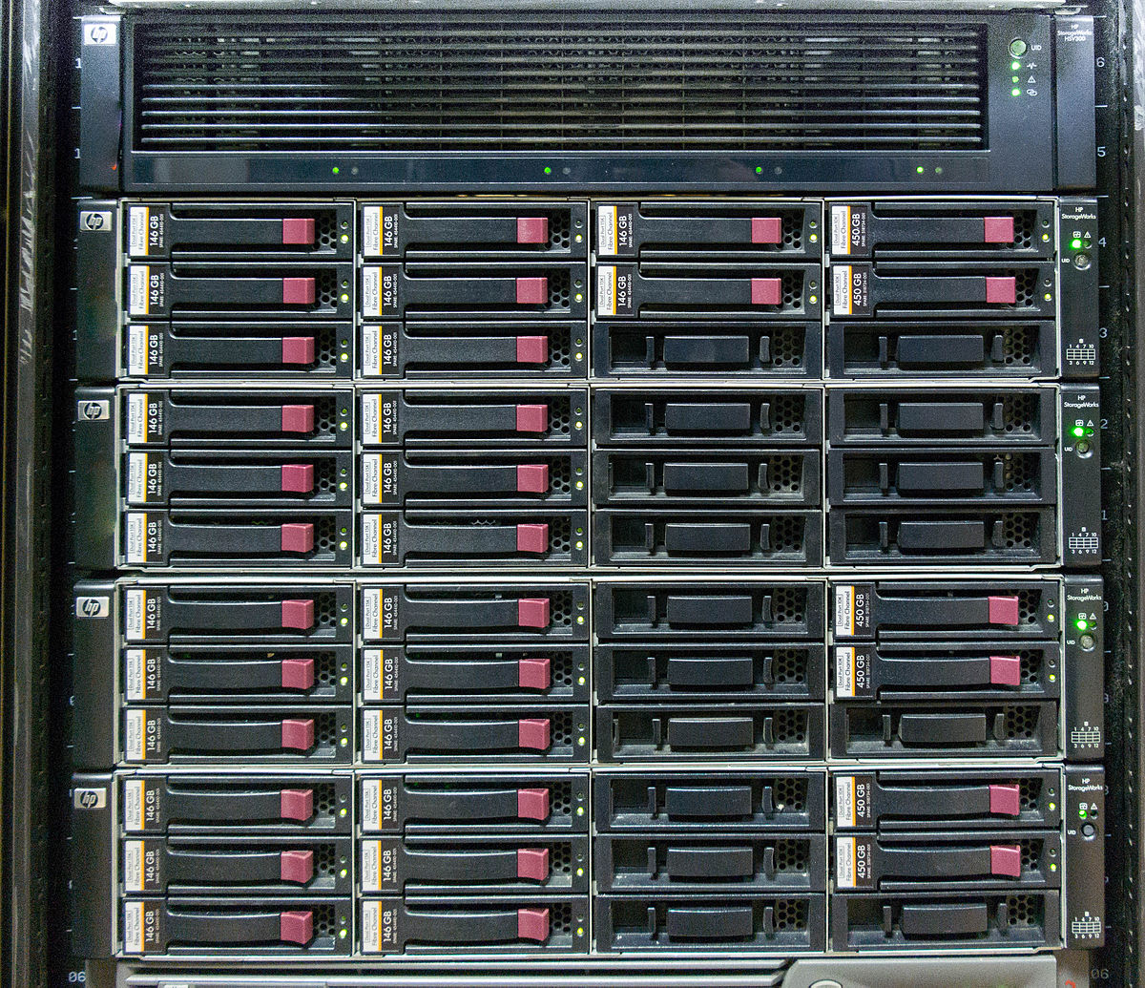
What is SAN Used for?
In the simplest terms, SAN can be considered a network of disks which is accessible by a network of servers.
Some of the most popular uses for SANs are:
Data Center Servers
Storage Arrays
Improving Storage Availability

Slide 8
How SAN Works
A SAN is usually made up of three layers:
Host Layer – It represents the servers that are attached to the SAN
Fabric Layer – This layer includes the physical network devices such as cables and routers,
Storage Layer - This layer includes all the storage devices which have been collected in a pool together. This layer mostly includes HDDs or SSDs organized in a RAID array.
A SAN also includes the protocols that allow the communication of devices over the network. The most important protocol here is the Fiber Channel Protocol which controls iSCSI commands over the Fabric Layer.

Slide 9
Setting Up a SAN
The Process of setting up a SAN first requires the system to meet the hardware requirements. Once it has been gathered, the user needs to:
Assemble the hardware components together and connect them over the fabric layer with cables.
Change any settings that may require changing.
Test the integration.
Establish a performance baseline for every component.
Document the SAN installation.

Slide 10
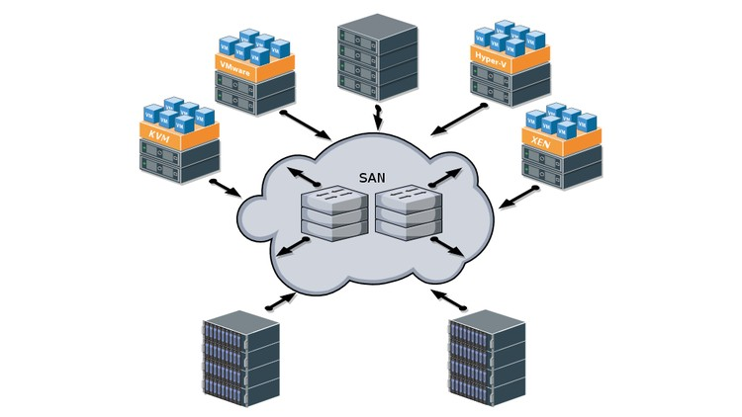
Benefits of SAN
High Performance
High Scalability
High Availability
Advanced Management Features

Slide 11
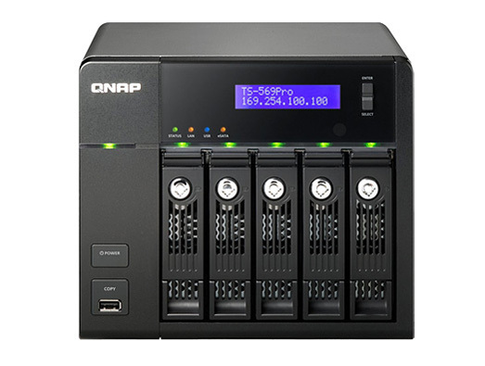
Disadvantages of SAN
Complexity
Scale and Cost
High maintenance

Slide 12
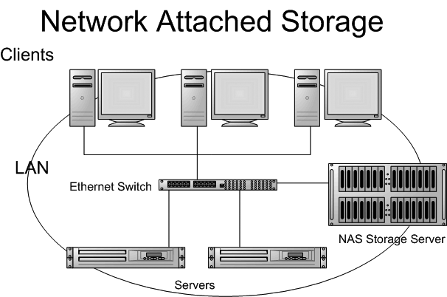
NAS (Network Attached Storage)
NAS stands for Network Attached Storage. It is commonly defined as a computer connected to a network which provides file-based data storage services to other devices on the same network.
It has File-Level Storage and uses the NFS, SMB/CIFS, AFP Protocols.

Slide 13
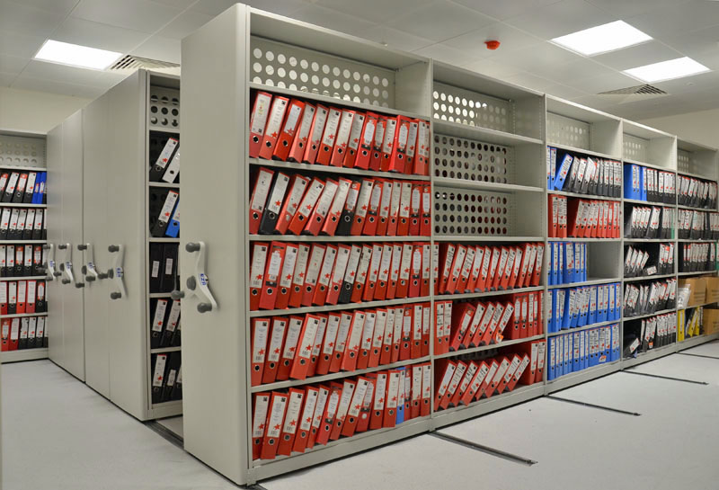
NAS is File Level Storage
File Level Storage is the storage form used for unstructured data and is commonly deployed in NAS systems.
It uses the NFS (Network File System) protocol for Linux.

Slide 14
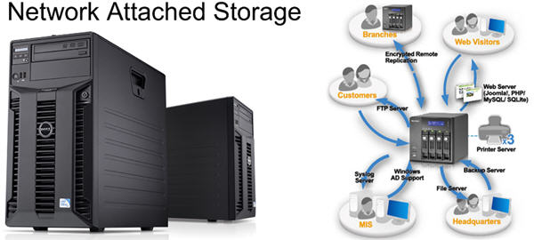
What is NAS Used for?
NAS is relatively simple when compared with SAN. This makes it simpler for use at home.
Some of the most popular uses for NAS are:
Backups
Storing media to stream locally
Collaboration

Slide 15
How it Works
A NAS device is commonly made up of the following parts:
NAS Head (CPU and Memory)
Optimized Operating System such as a Linux distro
NFS and CIFS protocols
Storage Protocols
IP Network

Slide 16
Setting Up a NAS with SAMBA
SAMBA is an open-source implementation of the SMB/CIFS protocols that allow users to access resources over a network.
In computer networking, Server Message Block, one version of which was also known as Common Internet File System, is a communication protocol for providing shared access to files, printers, and serial ports between nodes on a network. It also provides an authenticated inter-process communication mechanism.
The process for setting up a NAS with SAMBA is as follows:

Slide 17
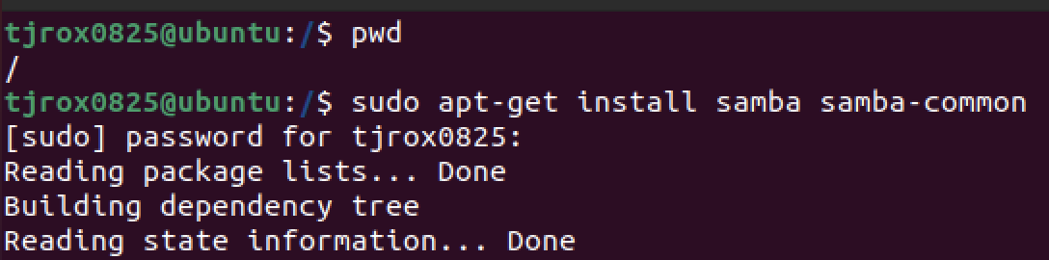
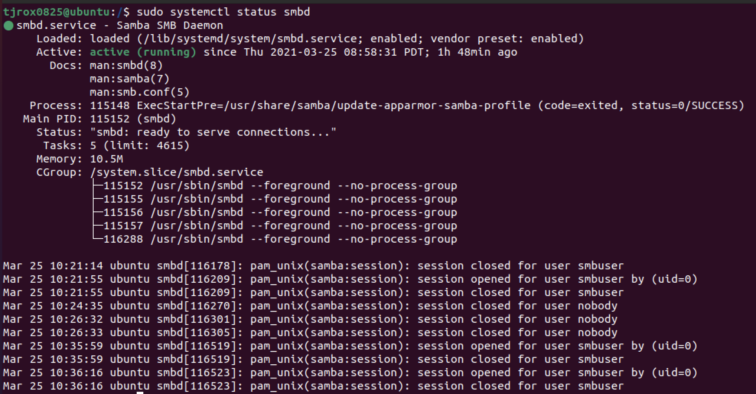
1. Install SAMBA on Ubuntu
Update apt packages index
Run - $sudo apt install samba
Check whether SAMBA is running with - $sudo systemct1 status smbd

Slide 18
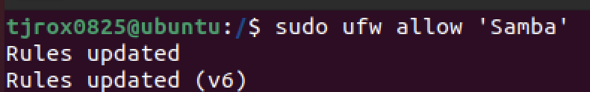
2. Configuring firewall
Run - $sudo ufw allow ‘Samba’

Slide 19
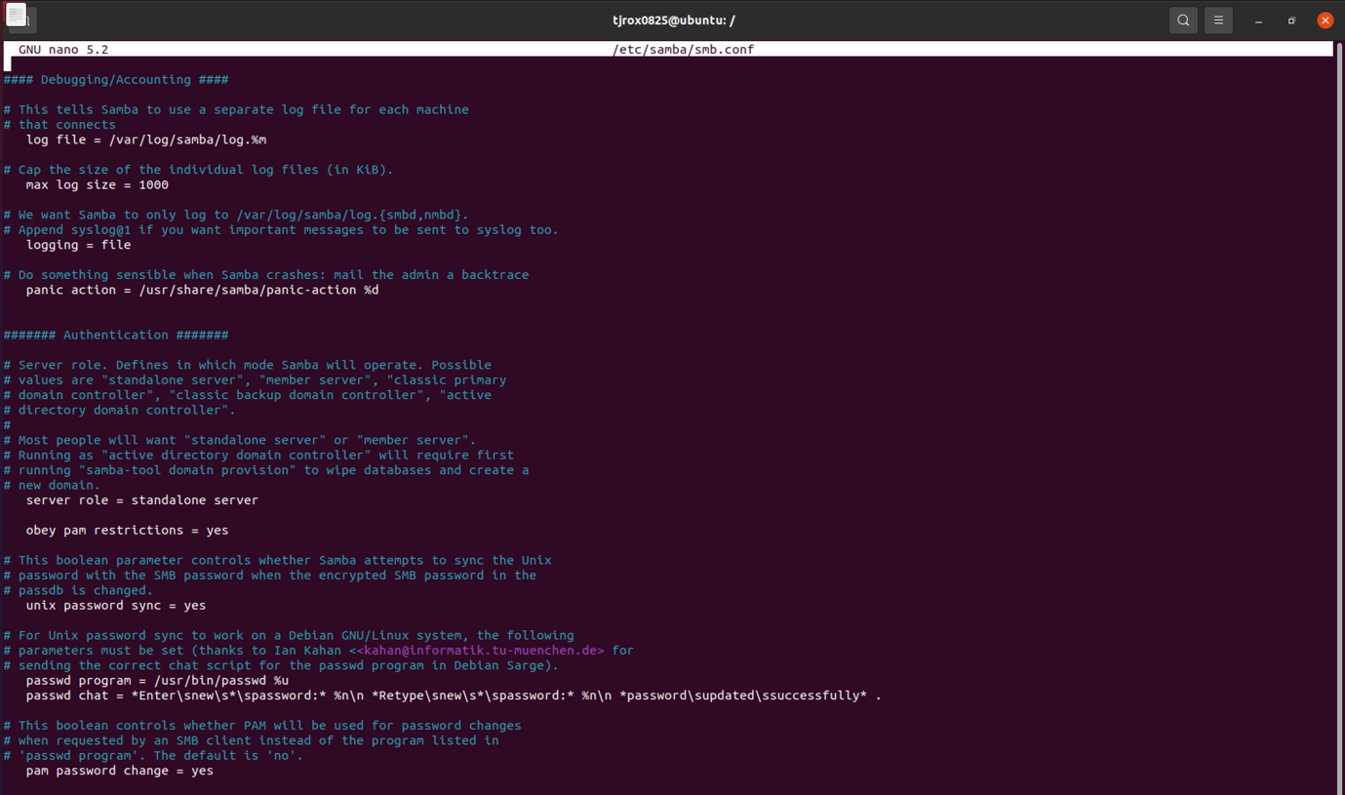
3. Configure Global Samba Options
Create a backup of the SAMBA config file: sudo cp /etc/samba/smb.conf{,.backup}
Set server role to standalone server
Restart SAMBA Services: sudo systemctl restart smbd sudo systemctl restart nmbd

Slide 20
4. Create SAMBA User
Create a new user named sambauser.
Set directory ownership to sambauser.

Slide 21
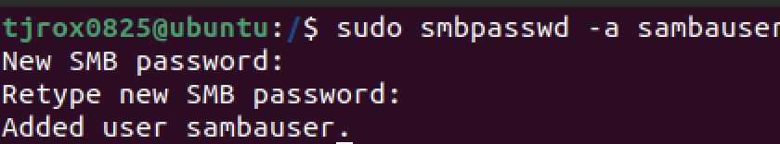
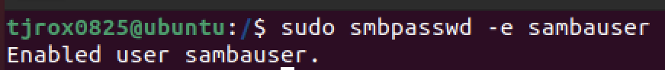
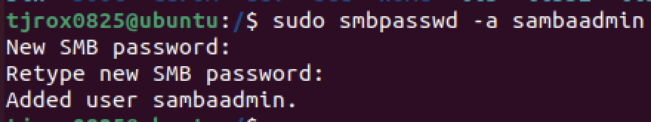
5. Enabling the Account
Set a password for sambauser
Enable the Samba Account
Create user sambaadmin
Set a password and enable sambaadmin

Slide 22
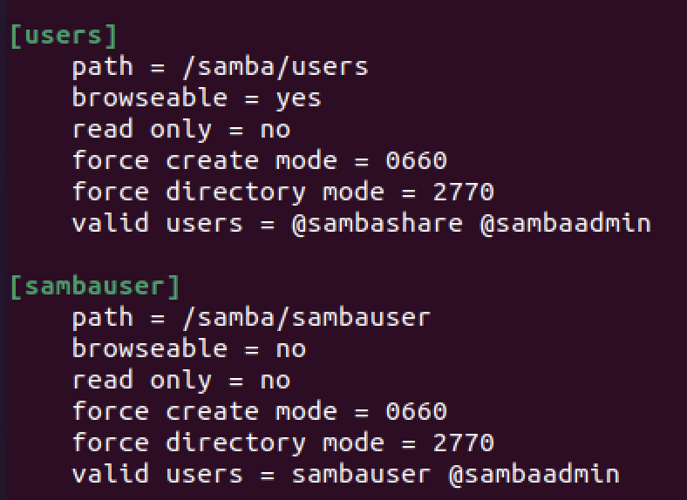
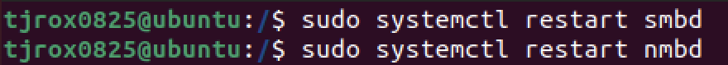
6. Configuring Samba Shares
Creating Users share directory: sudo mkdir /samba/users
Setting Directory Ownership to sambaadmin and group sambashare : sudo chown sambaadmin:sambashare /samba/users
Giving Read/write permission to sambashare group in samba/user directory: sudo chmod 2770 /samba/users
Restarting Samba Services:

Slide 23
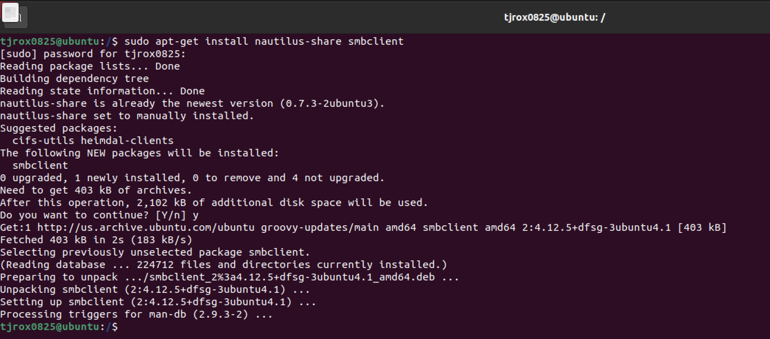
7. Configuration of Ubuntu Client
Now, to access the SAMBA NAS from Linux, install smbclient via apt and then run the following command:

Slide 24
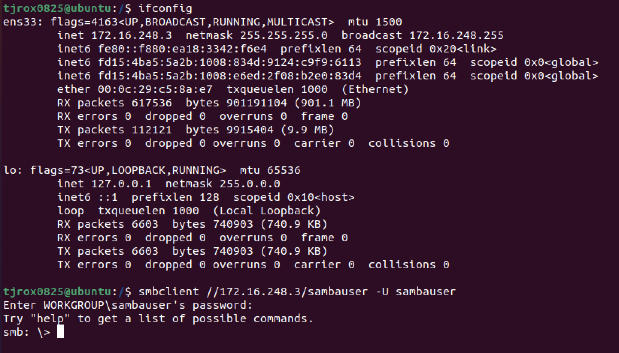
7. Connecting to Server
smbclient//samba_hostname_or_server ip/share_name -U username
You will be required to enter the password and then you will be logged into the SAMBA interface

Slide 25
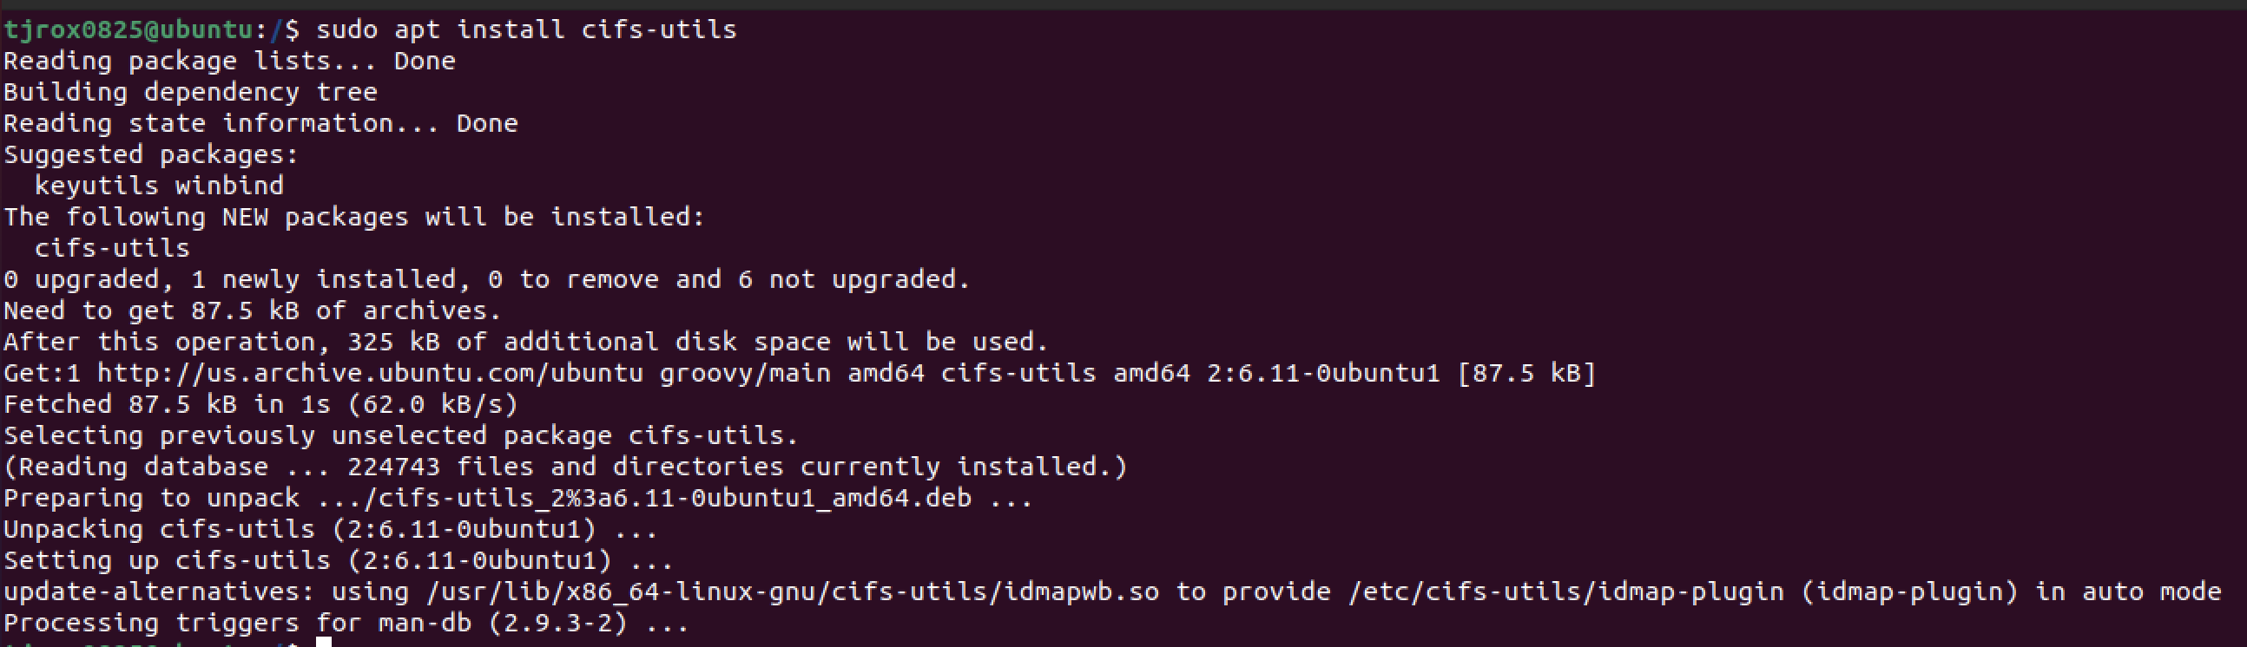
8. Mounting the Samba Share
Installing the cifs package:
Creating a mount point: sudo mkdir /mnt/sambamount
Mounting the share:

Slide 26
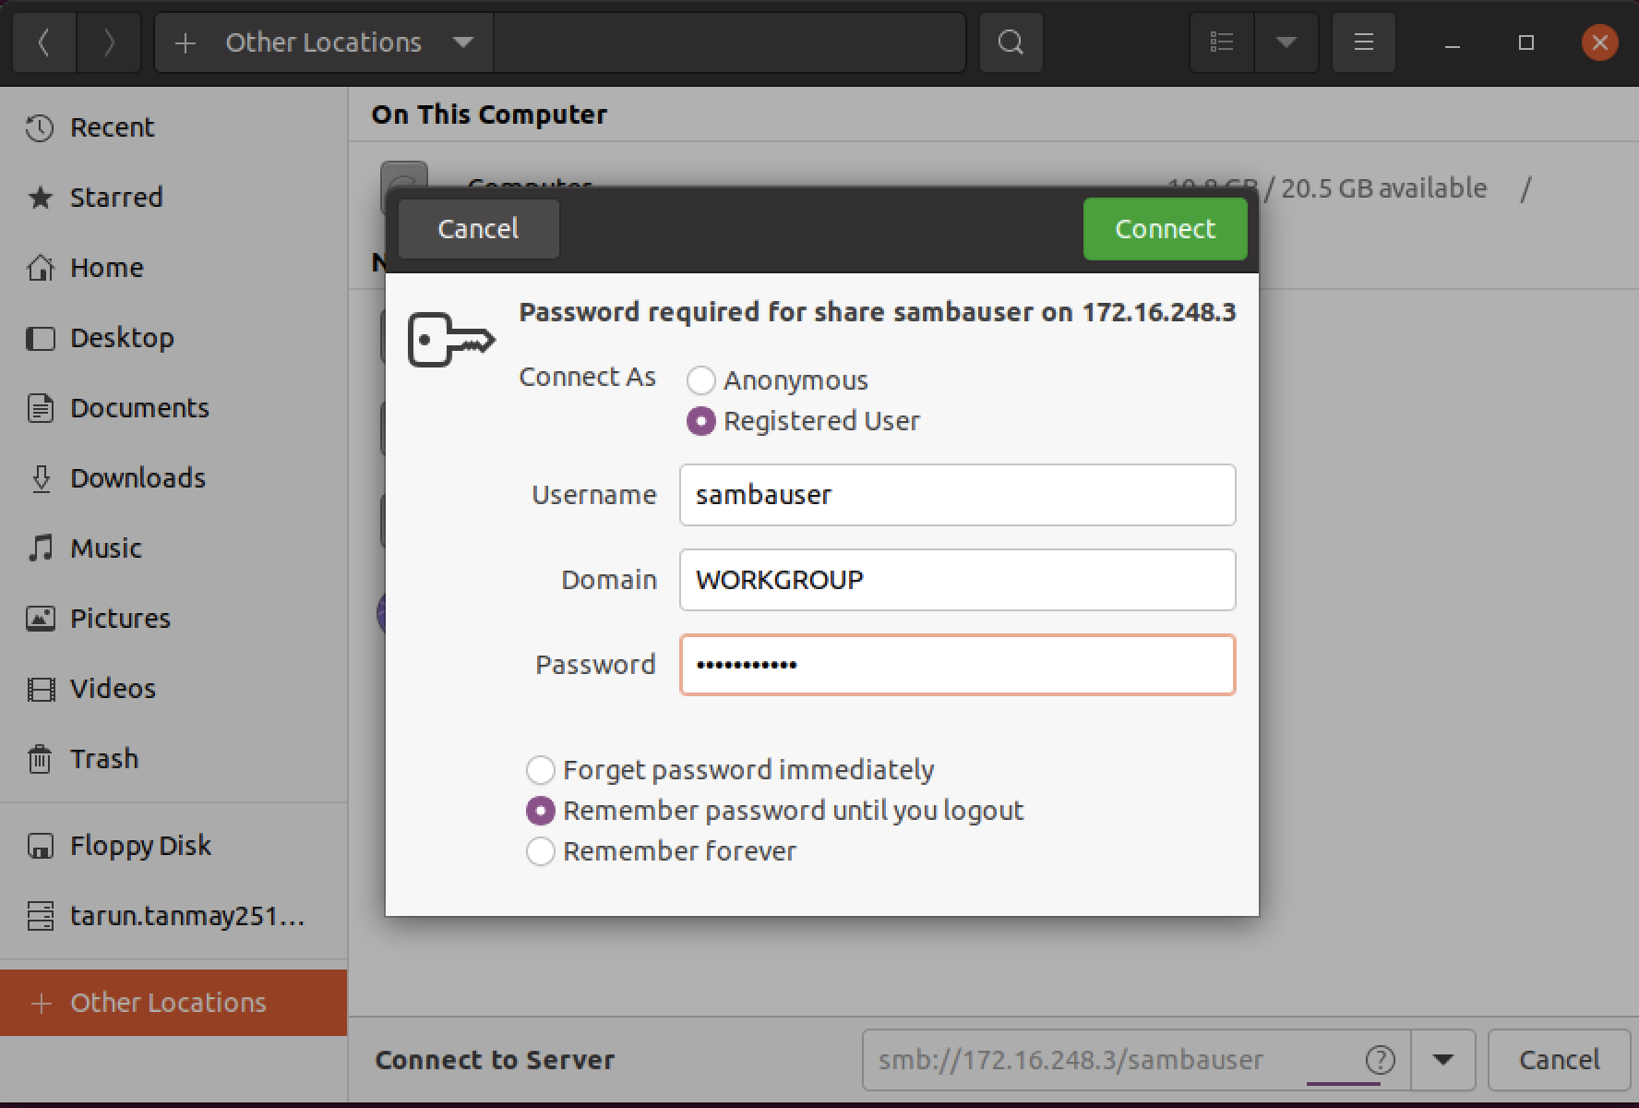
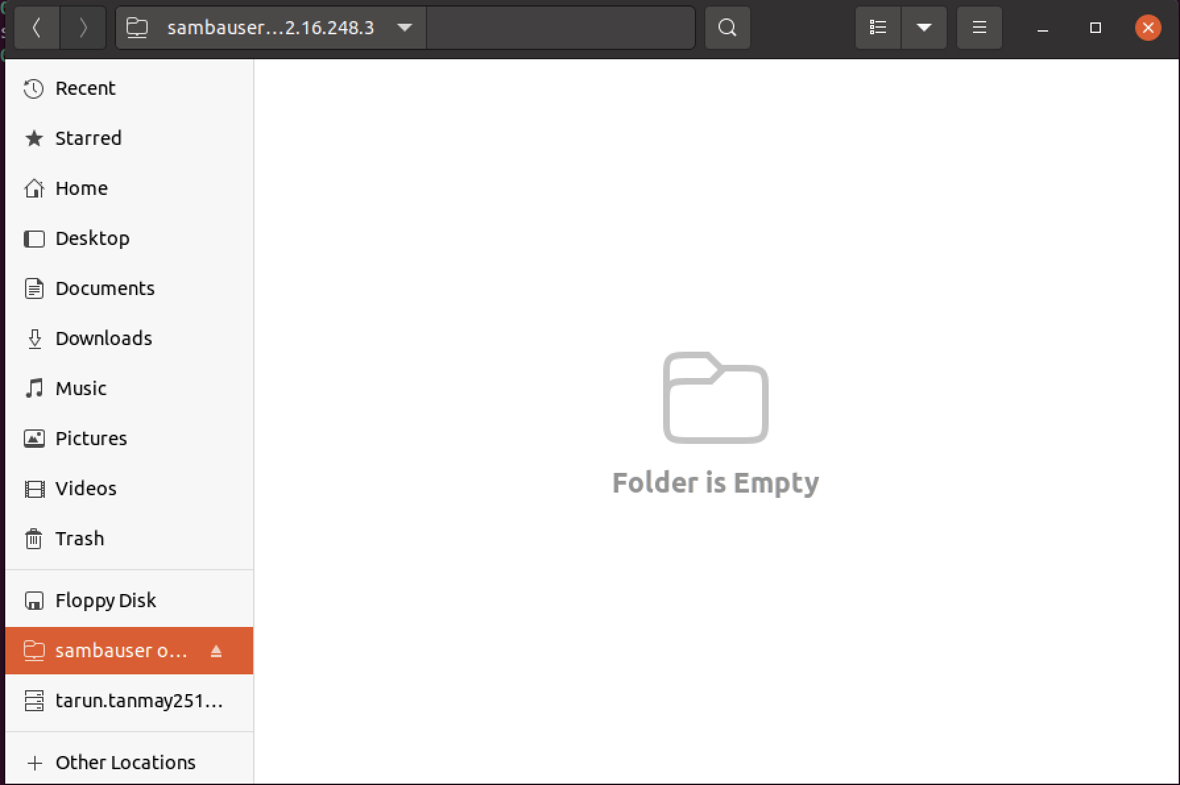
9. Finishing Up
Using the GUI:

Slide 27
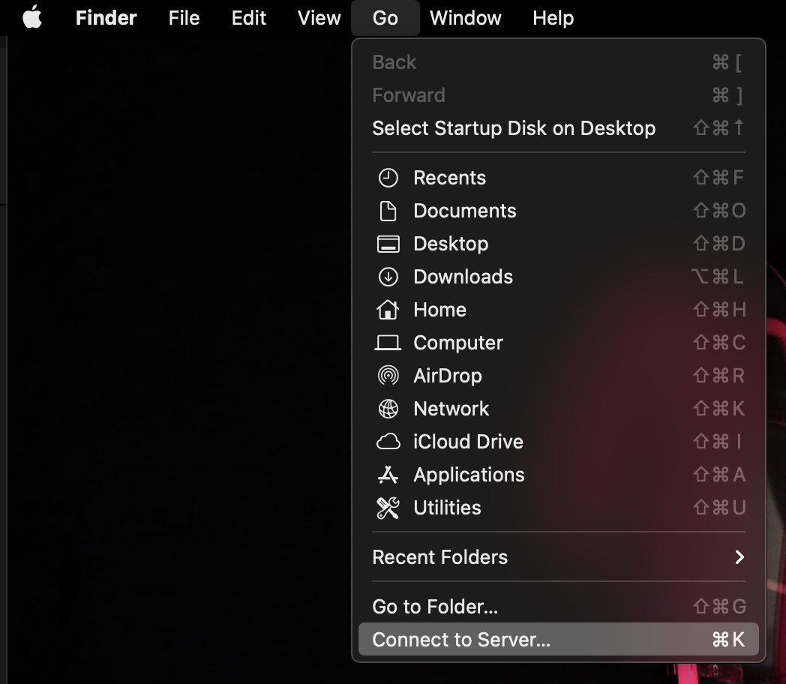
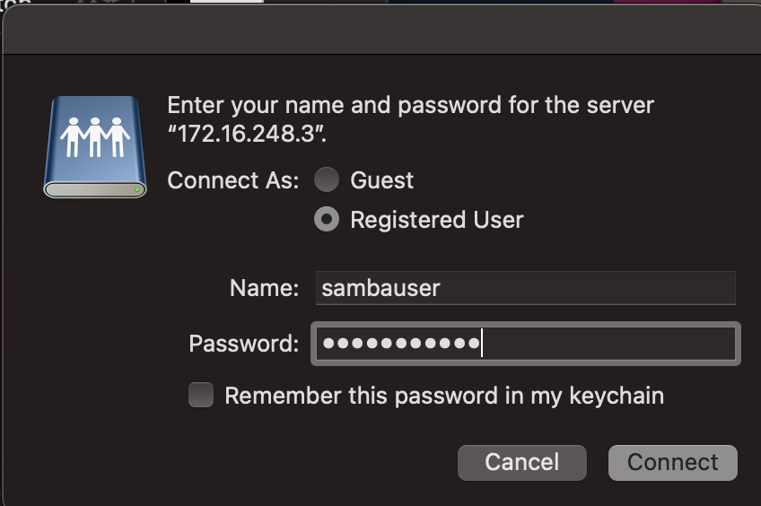
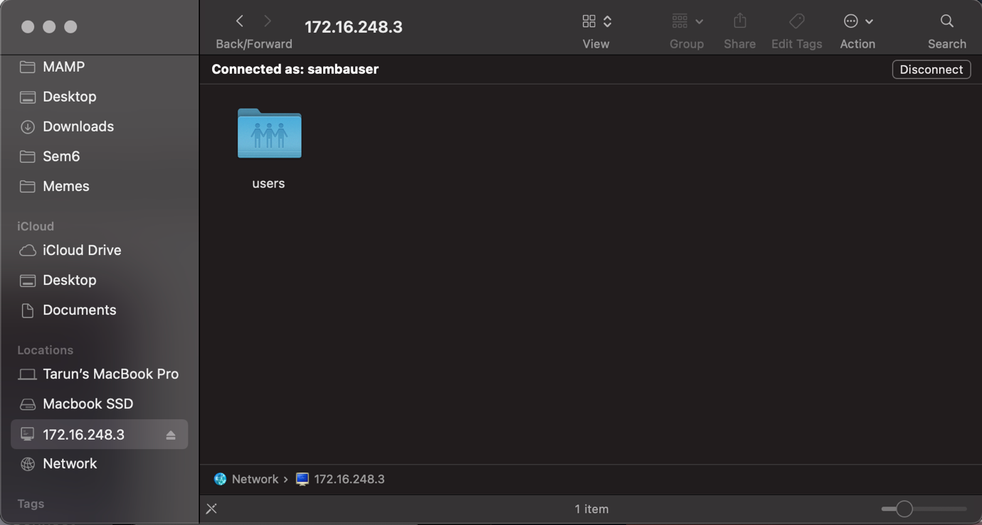
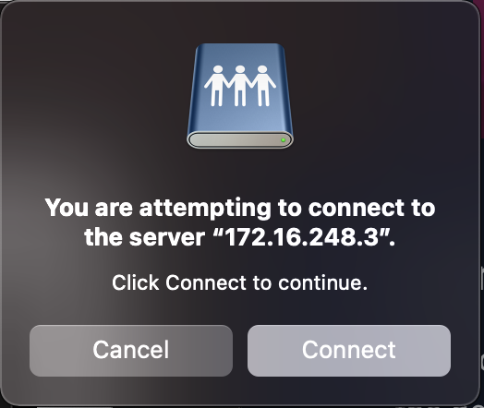
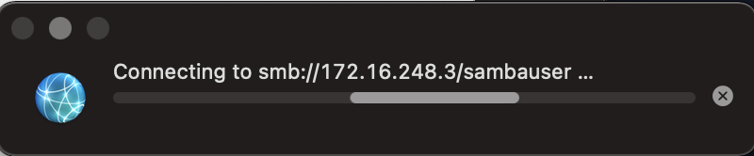
10. Connecting to Samba Share from macOS

Slide 28
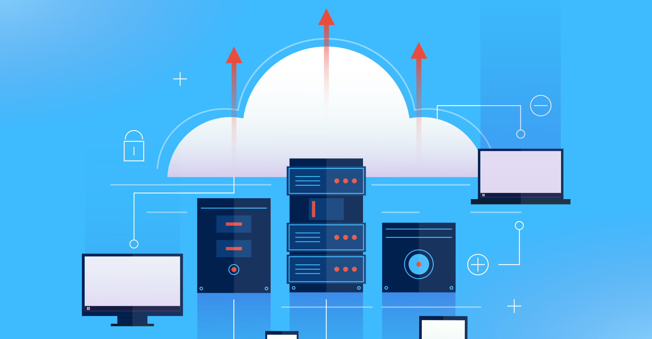
Benefits of NAS
Central Storage and Access
Automated Local Cloud Backup
Easy setup
Virtually 0 hardware costs
Space saving
Affordable file storage option

Slide 29
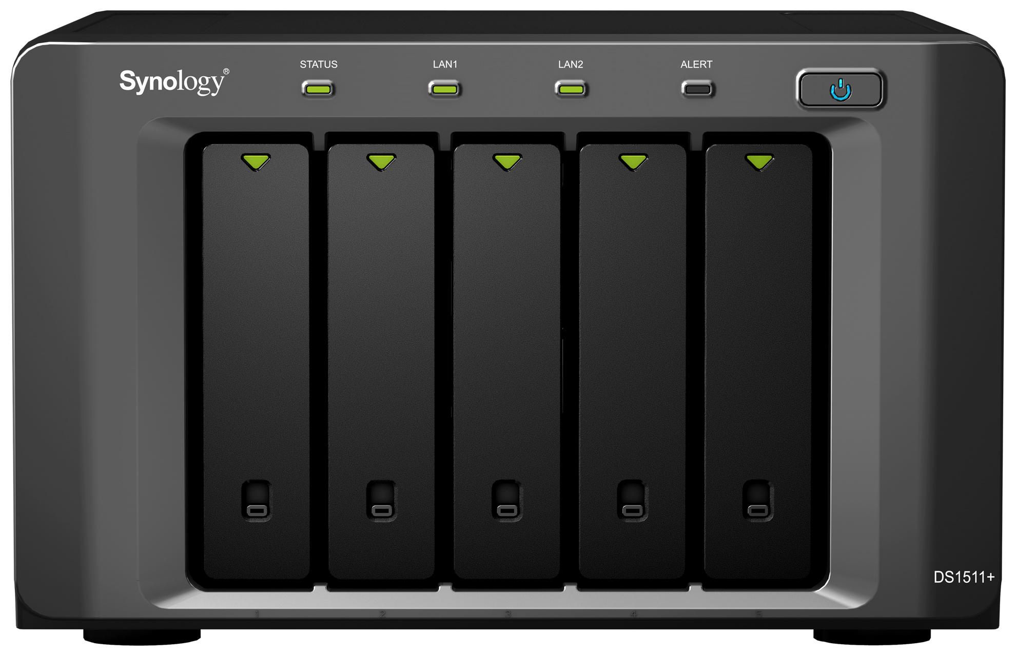
Disadvantages of NAS
Onsite backup which is vulnerable to natural disasters.
Difficult recovery from another operating system like Windows.
Backup cannot be done via other OS.
Slow data transfer speeds when compared to SAN.

Slide 30
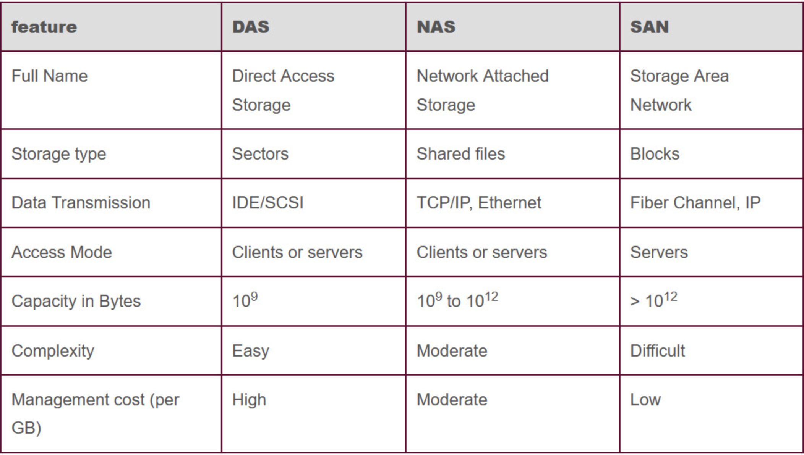
Comparisons

Slide 31
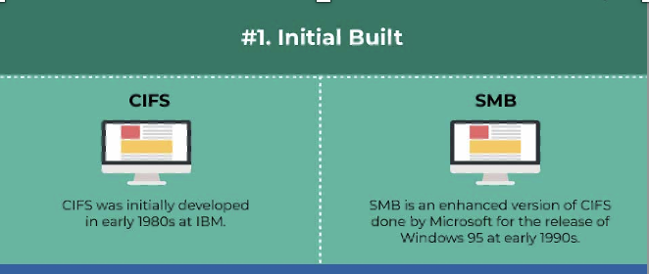
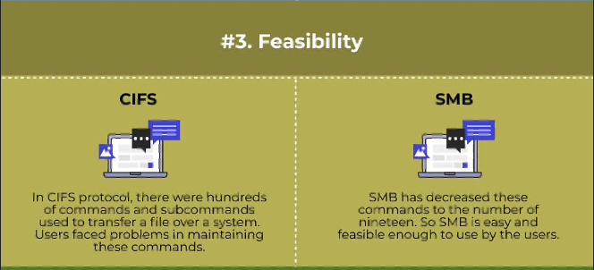
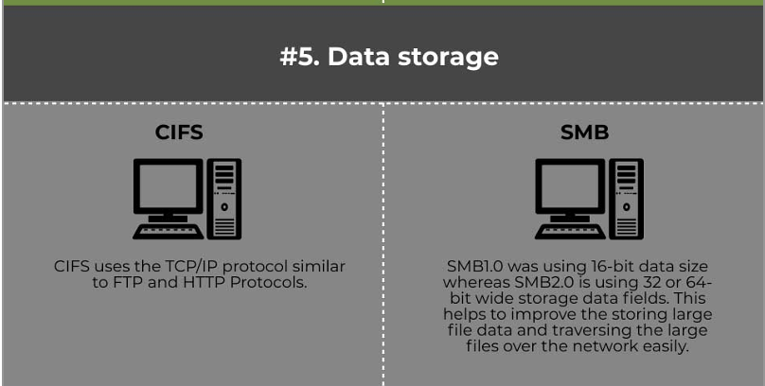
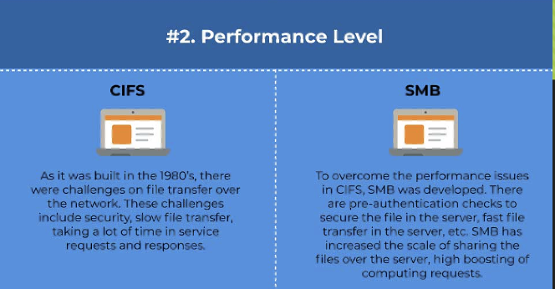
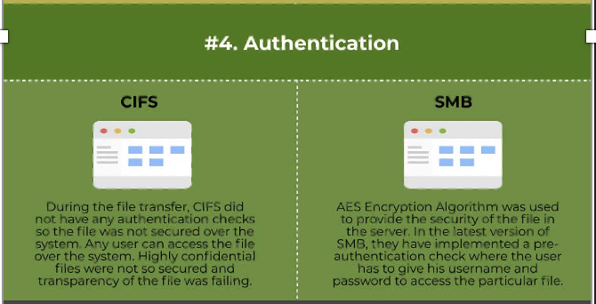
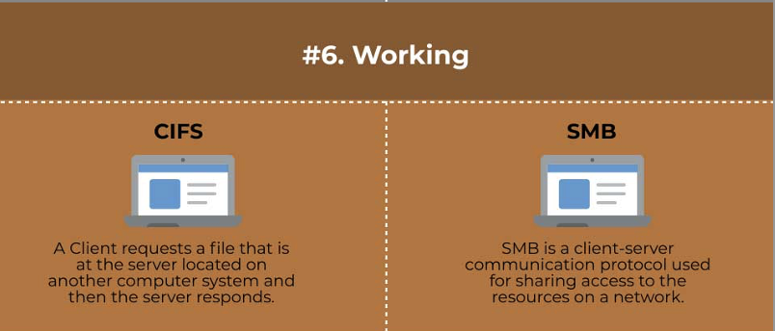
CIFS VS SMB

Slide 32

References:
Storage Technology information, news and tips - SearchStorage (techtarget.com)
Pros and Cons of NAS | NAS storage Dubai | Network IT solutions (whitehatsme.com)
https://www.enterprisestorageforum.com/hardware/network-storage/
https://www.slideshare.net/ShashankBhatnagar3/nas-network-attached-storage-64574337
https://www.redhat.com/sysadmin/san-vs-nas
https://www.slideshare.net/ShashankBhatnagar3/nas-network-attached-storage-64574337
5 cool and creative ways to use NAS | Windows Central
https://linuxize.com/post/how-to-install-and-configure-samba-on-ubuntu-18-04/
CIFS vs SMB | Learn 6 Most Amazing Comparisons of CIFS vs SMB (educba.com)

Slide 33
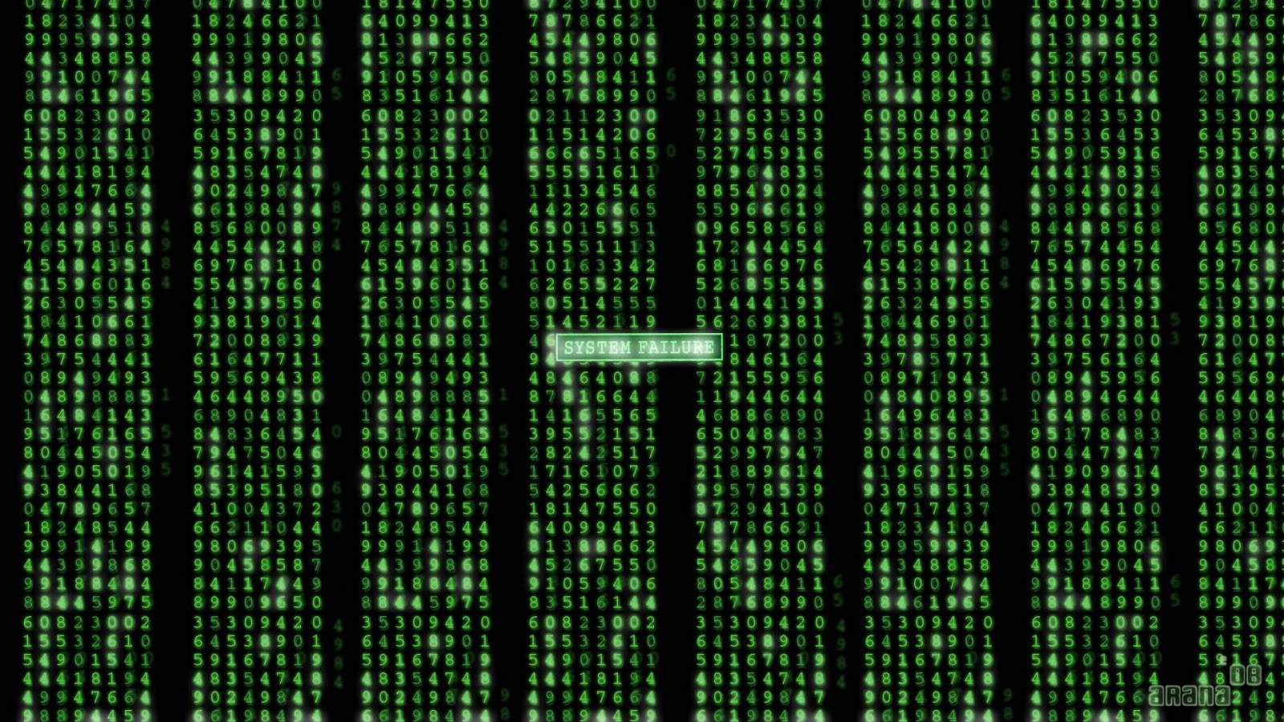
Thank You

